Slide 1
Correlation
Md. Ismail Hossain Riday

Slide 2
Correlation
In real life situations, especially in social sciences and in business, we often to know whether two or more variables are related, and if so, how they are related.
The following are some questions of interest,
Is there a relationship between two or more variables?
If so, what is the relationship?

Slide 3
Correlation
Association
Connection
Relationship

Slide 4
Correlation
Relationship between two or more variables

Slide 5
Correlation
Relationship between two or more variables
Which gives us strength or degree

Slide 6
Correlation
Relationship between two or more variables
Which gives us strength or degree and direction of association
Correlation:
Relationship between two or more variables which gives us strength or degree and direction of association

Slide 7
Objectives
The primary objective of correlation analysis is to measure,
Degree or strength of relationships
Direction of relationship

Slide 8
Types of Correlation
On the basis of direction
Positive correlation
On the basis of variables
Simple correlation
On the basis of linearity
Negative correlation
Multiple correlation
Linear correlation
Non-Linear correlation

Slide 9
Types of Correlation
On the basis of direction
Positive correlation
On the basis of variables
Simple correlation
On the basis of linearity
Negative correlation
Multiple correlation
Linear correlation
Non-Linear correlation

Slide 10
Types of Correlation
On the basis of direction
Positive correlation
On the basis of variables
Simple correlation
On the basis of linearity
Negative correlation
Multiple correlation
Linear correlation
Non-Linear correlation

Slide 11
Types of Correlation
On the basis of direction
Positive correlation
On the basis of variables
Simple correlation
On the basis of linearity
Negative correlation
Multiple correlation
Linear correlation
Non-Linear correlation

Slide 12
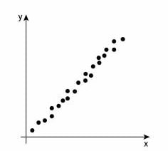
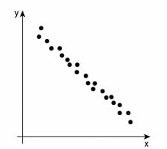
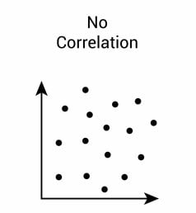
Types of Correlation
On the basis of direction
Positive correlation
On the basis of variables
Simple correlation
On the basis of linearity
Negative correlation
Multiple correlation
Linear correlation
Non-Linear correlation

Slide 13
Types of Correlation
On the basis of direction
Positive correlation
On the basis of variables
Simple correlation
On the basis of linearity
Negative correlation
Multiple correlation
Linear correlation
Non-Linear correlation

Slide 14
Types of Correlation
On the basis of direction
Positive correlation
On the basis of variables
Simple correlation (Two variables)
On the basis of linearity
Negative correlation
Multiple correlation
Linear correlation
Non-Linear correlation

Slide 15
Types of Correlation
On the basis of direction
Positive correlation
On the basis of variables
Simple correlation
On the basis of linearity
Negative correlation
Multiple correlation (More than two)
Linear correlation
Non-Linear correlation

Slide 16
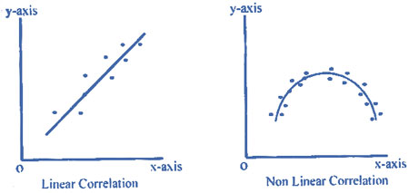
Types of Correlation
On the basis of direction
Positive correlation
On the basis of variables
Simple correlation
On the basis of linearity
Negative correlation
Multiple correlation
Linear correlation
Non-Linear correlation

Slide 17
Measures
Correlation can be measured by
Scatter Diagram
Karl Pearson’s Correlation Coefficient
Spearman Rank Correlation Coefficient
Method of Least Square

Slide 18
Scatter Diagram
Draw the scatter diagram
Is there any relationship between “Age” and “Glucose Level”?
Age | Glucose Level
43 | 99
21 | 65
25 | 79
42 | 75
57 | 87
With the increase of age, the Glucose Level also increased. Thus, there is a positive correlation between “Age” and “Glucose Level”.

Slide 19
Limitations
Accurate degree and strength of correlation can not be obtained by scatter diagram.

Slide 20
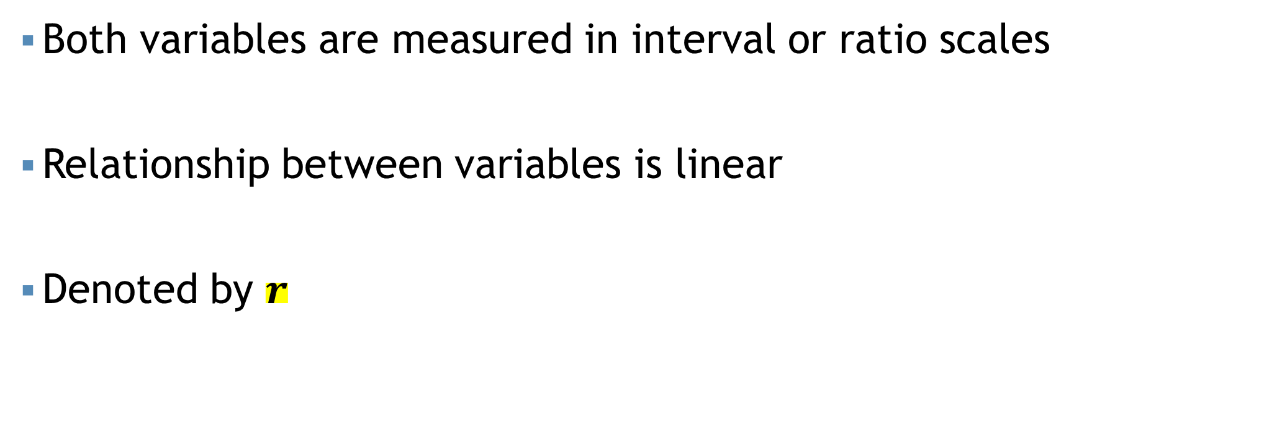
Karl Pearson’s Correlation
Both variables are measured in interval or ratio scales
Relationship between variables is linear
Denoted by $r$

Slide 21
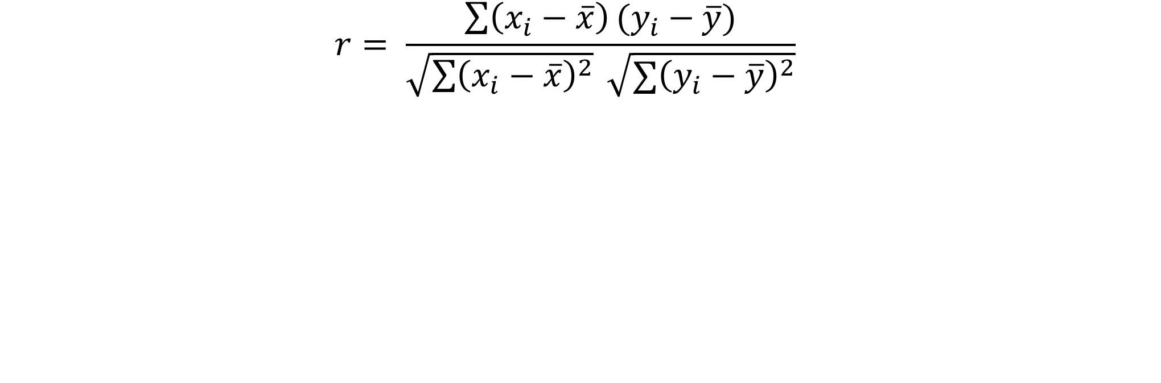
Karl Pearson’s Correlation
$$r= \frac{\sum{\left(x_{i}−\overline{x}\right)}(y_{i}−\overline{y})}{\sqrt{\sum{{\left(x_{i}−\overline{x}\right)}^{2}}} \sqrt{{∑\left(y_{i}−\overline{y}\right)}^{2}}}$$

Slide 22
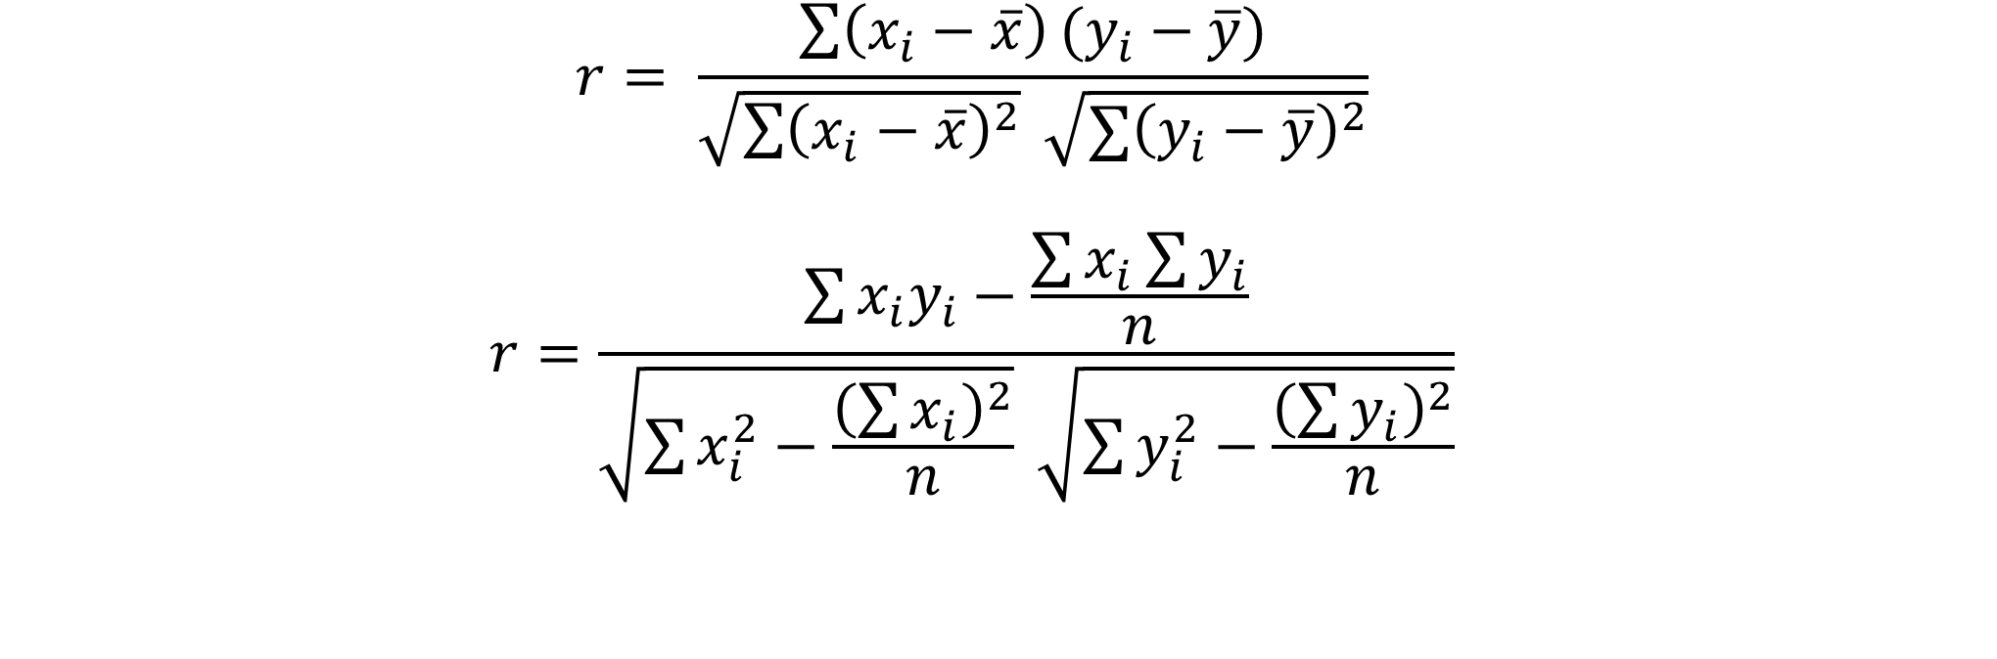
Karl Pearson’s Correlation
$$r= \frac{\sum{\left(x_{i}−\overline{x}\right)}(y_{i}−\overline{y})}{\sqrt{\sum{{\left(x_{i}−\overline{x}\right)}^{2}}} \sqrt{{∑\left(y_{i}−\overline{y}\right)}^{2}}}$$
$$r=\frac{\sum{x_{i}y_{i}}−\frac{\sum{x_{i}}\sum{y_{i}}}{n}}{\sqrt{\sum{x_{i}^{2}}−\frac{{\left(\sum{x_{i}}\right)}^{2}}{n}} \sqrt{\sum{y_{i}^{2}}−\frac{{\left(\sum{y_{i}}\right)}^{2}}{n}}}$$

Slide 23

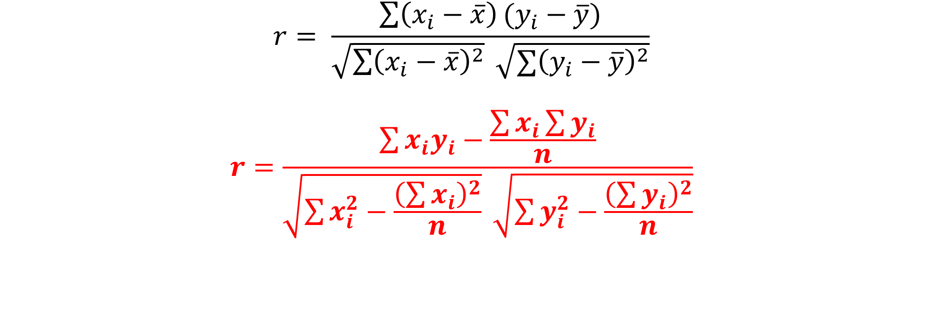


Karl Pearson’s Correlation
$$r= \frac{\sum{\left(x_{i}−\overline{x}\right)}(y_{i}−\overline{y})}{\sqrt{\sum{{\left(x_{i}−\overline{x}\right)}^{2}}} \sqrt{{∑\left(y_{i}−\overline{y}\right)}^{2}}}$$
$$r=\frac{\sum{x_{i}y_{i}}−\frac{\sum{x_{i}}\sum{y_{i}}}{n}}{\sqrt{\sum{x_{i}^{2}}−\frac{{\left(\sum{x_{i}}\right)}^{2}}{n}} \sqrt{\sum{y_{i}^{2}}−\frac{{\left(\sum{y_{i}}\right)}^{2}}{n}}}$$
Correlation | Negative | Positive
Weak | -0.29 to -0.10 | 0.10 to 0.29
Medium | -0.49 to -0.30 | 0.30 to 0.49
Moderate | -0.50 to -0.79 | 0.50 to 0.79
Strong | -1.00 to -0.80 | 0.80 to 1.00
Range of r is [-1 to +1]
If $r=+1$; Perfect positive correlation
If $r=−1$; Perfect negative correlation
If $r=0$; No correlation

Slide 24
Karl Pearson’s Correlation
Example: The monthly income and saving data for a sample of 10 garments workers are given below:
Income ($) | Savings ($)
60 | 5
66 | 7
66 | 8
66 | 9
68 | 11
68 | 12
70 | 14
72 | 16
74 | 21
80 | 27
Draw the scatter plot
Compute the correlation coefficient value with proper interpretation
If the 9th value of "Savings" is changed to 23, calculate the updated correlation coefficient.

Slide 25
Karl Pearson’s Correlation
Example: The monthly income and saving data for a sample of 10 garments workers are given below:
Income ($) | Savings ($)
60 | 5
66 | 7
66 | 8
66 | 9
68 | 11
68 | 12
70 | 14
72 | 16
74 | 21
80 | 27
Draw the scatter plot

Slide 26
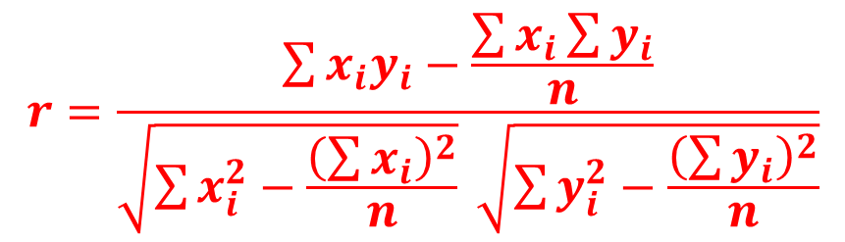
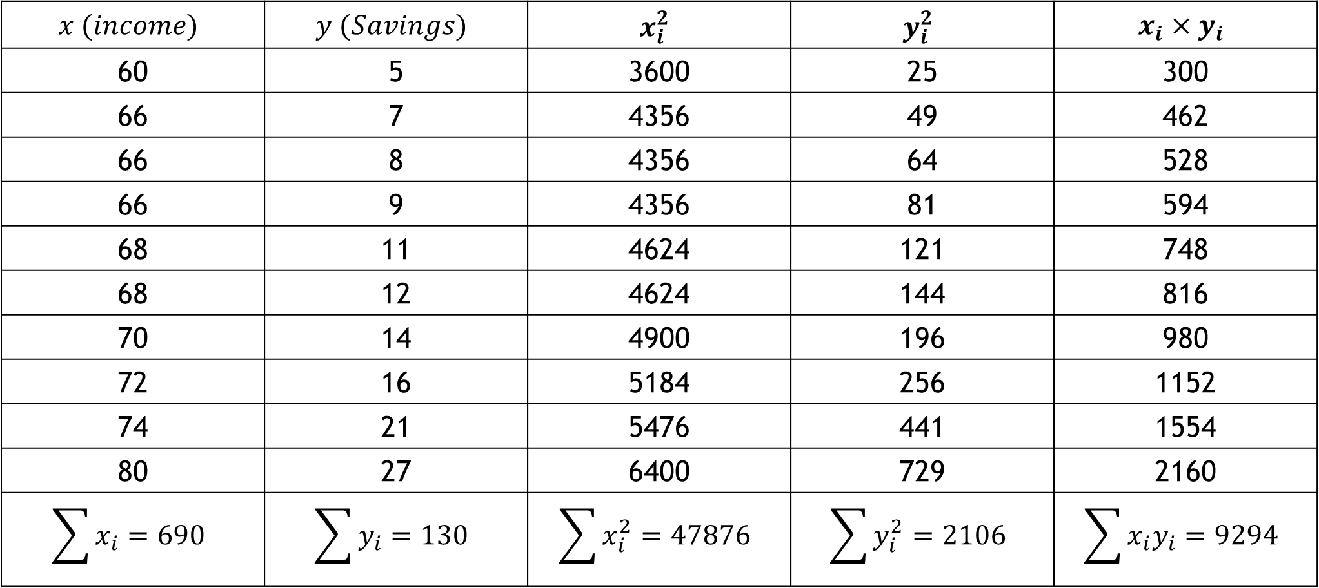
Cont.
$$r=\frac{\sum{x_{i}y_{i}}−\frac{\sum{x_{i}}\sum{y_{i}}}{n}}{\sqrt{\sum{x_{i}^{2}}−\frac{{\left(\sum{x_{i}}\right)}^{2}}{n}} \sqrt{\sum{y_{i}^{2}}−\frac{{\left(\sum{y_{i}}\right)}^{2}}{n}}}$$
$$x (income)$$ | $$y (Savings)$$ | $$x_{i}^{2}$$ | $$y_{i}^{2}$$ | $$x_{i}×y_{i}$$
60 | 5 | 3600 | 25 | 300
66 | 7 | 4356 | 49 | 462
66 | 8 | 4356 | 64 | 528
66 | 9 | 4356 | 81 | 594
68 | 11 | 4624 | 121 | 748
68 | 12 | 4624 | 144 | 816
70 | 14 | 4900 | 196 | 980
72 | 16 | 5184 | 256 | 1152
74 | 21 | 5476 | 441 | 1554
80 | 27 | 6400 | 729 | 2160
$$\sum{x_{i}}=690$$ | $$\sum{y_{i}}=130$$ | $$\sum{x_{i}^{2}}=47876$$ | $$\sum{y_{i}^{2}}=2106$$ | $$\sum{x_{i}y_{i}}=9294$$

Slide 27

Cont.
Now, the correlation coefficient
$$r=\frac{\sum{x_{i}y_{i}}−\frac{\sum{x_{i}}\sum{y_{i}}}{n}}{\sqrt{\sum{x_{i}^{2}}−\frac{{\left(\sum{x_{i}}\right)}^{2}}{n}} \sqrt{\sum{y_{i}^{2}}−\frac{{\left(\sum{y_{i}}\right)}^{2}}{n}}}=\frac{9294−\frac{690×130}{10}}{\sqrt{47876−\frac{{\left(690\right)}^{2}}{10}}\sqrt{2106−\frac{{\left(130\right)}^{2}}{10}}}=0.97$$

Slide 28
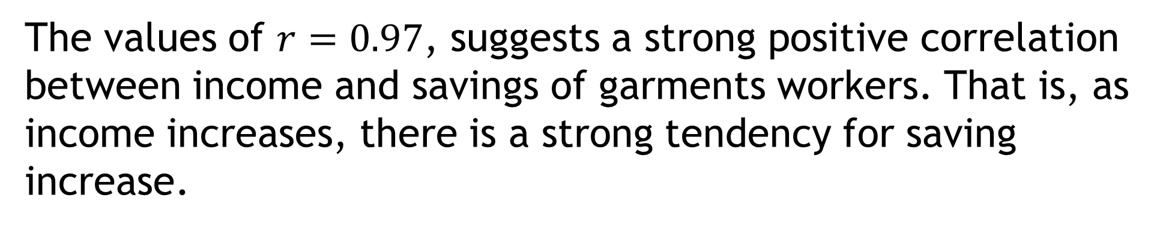
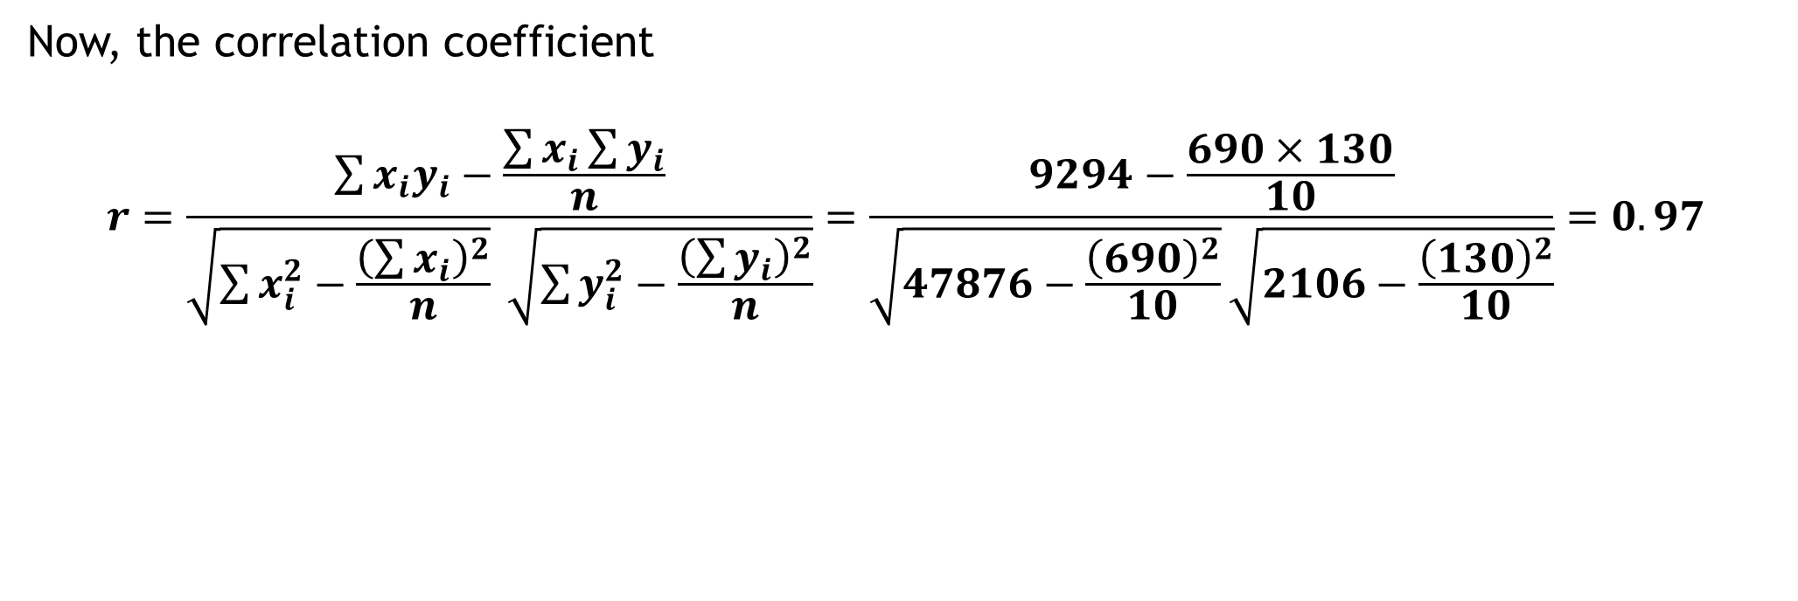
Cont.
Correlation | Negative | Positive
Weak | -0.29 to -0.10 | 0.10 to 0.29
Medium | -0.49 to -0.30 | 0.30 to 0.49
Moderate | -0.50 to -0.79 | 0.50 to 0.79
Strong | -1.00 to -0.80 | 0.80 to 1.00
Now, the correlation coefficient
$$r=\frac{\sum{x_{i}y_{i}}−\frac{\sum{x_{i}}\sum{y_{i}}}{n}}{\sqrt{\sum{x_{i}^{2}}−\frac{{\left(\sum{x_{i}}\right)}^{2}}{n}} \sqrt{\sum{y_{i}^{2}}−\frac{{\left(\sum{y_{i}}\right)}^{2}}{n}}}=\frac{9294−\frac{690×130}{10}}{\sqrt{47876−\frac{{\left(690\right)}^{2}}{10}}\sqrt{2106−\frac{{\left(130\right)}^{2}}{10}}}=0.97$$
The values of $r=0.97$, suggests a strong positive correlation between income and savings of garments workers. That is, as income increases, there is a strong tendency for saving increase.

Slide 29


Cont.
Corrected Part:
$\sum{X}=690$
$\sum{X^{2}}=47876$ $\sum{Y=\left(130−21\right)}−23=???$
$\sum{Y^{2}=\left(2106−{21}^{2}\right)+{23}^{2}}=???$
$\sum{XY}=\left\{9294−\left(21×74\right)\right\}+\left(23×74\right)=???$
Now, the updated correlation coefficient
$$r=\frac{\sum{x_{i}y_{i}}−\frac{\sum{x_{i}}\sum{y_{i}}}{n}}{\sqrt{\sum{x_{i}^{2}}−\frac{{\left(\sum{x_{i}}\right)}^{2}}{n}} \sqrt{\sum{y_{i}^{2}}−\frac{{\left(\sum{y_{i}}\right)}^{2}}{n}}}=???=\frac{9294−\frac{690×130}{10}}{\sqrt{47876−\frac{{\left(690\right)}^{2}}{10}}\sqrt{2106−\frac{{\left(130\right)}^{2}}{10}}}=0.97$$

Slide 30
Self Practice
Following are the heights and weights of 10 students
Height | 62 | 72 | 68 | 58 | 65 | 70 | 66 | 63 | 60 | 72
Weight | 50 | 65 | 63 | 50 | 54 | 60 | 61 | 55 | 54 | 65

Slide 31
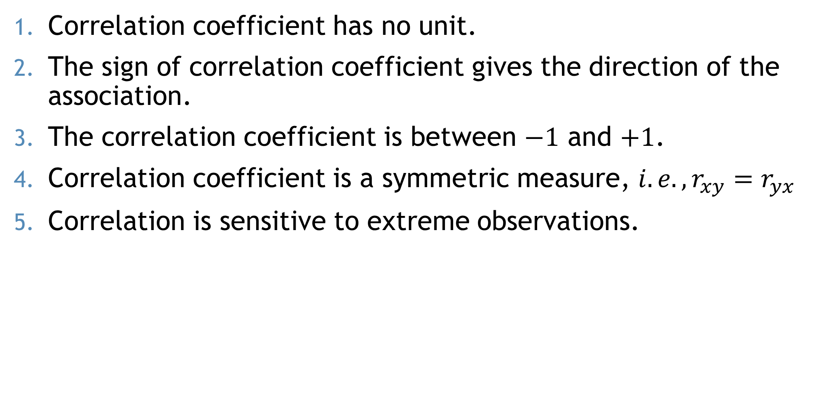
Properties
Correlation coefficient has no unit.
The sign of correlation coefficient gives the direction of the association.
The correlation coefficient is between $−1$ and $+1$.
Correlation coefficient is a symmetric measure, $i.e., r_{xy}=r_{yx}$
Correlation is sensitive to extreme observations.

Slide 32
Thank You

